Slide 1
Week 0
Introduction to Python

Slide 2
Contents
Week 0
About Me
About the course
About Python
Why code?
Accessing Resources
Generative AI
Accessing Me
Setup

Slide 3
Week 0
About Me

Slide 4

About Me
Week 0
Background in mathematics
PhD in applying Deep Learning in biology
Currently a PDRA applying AI to health data
Also freelance web developer

Slide 5
Week 0
About the Course

Slide 6
About The Course
Week 0
10 weeks, 2hrs per week
Practice and Project driven introduction to Python – we learn by doing!
Final aim: Give you the confidence to take the next steps to acheive your goals

Slide 7
About The Course
Week 0
Introduction
2. Control Flow
3. Iteration
4. Functions
5. File I/O
6. Classes and OOP
7. Packages
8. Development Tools
9. Regex – and more
10. Final Project

Slide 8
About The Course
Week 0
Introduction
2. Control Flow
3. Iteration
4. Functions
5. File I/O
6. Classes and OOP
7. Packages
8. Development Tools
9. Regex – and more
10. Final Project

Slide 9
Week 0
About Python

Slide 10
About Python
Week 0
Released in 1991
High Level, Interpreted, General Purpose Language
Currently the 2nd most used programming language in the world

Slide 11
Why Python?
Week 0
Extremely helpful community with plenty of resources
Versatile, accessible, industry standard
AI, data anaylsis, scripting, backend webdev
Good “starter language”

Slide 12
Week 0
Why Code?

Slide 13



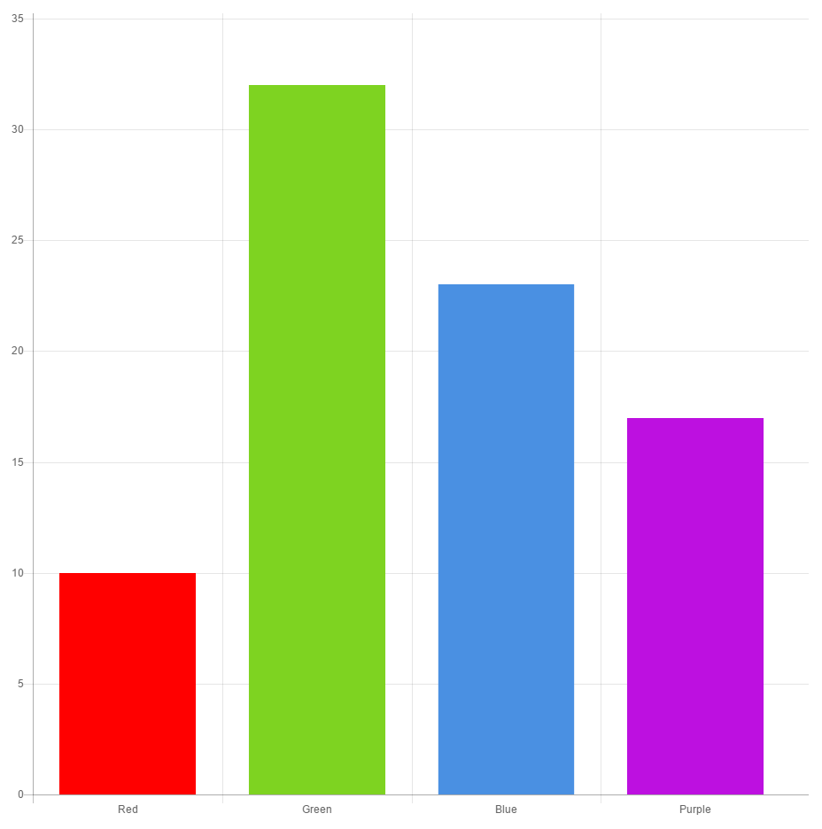



Why Code?
Week 0

Slide 14
Week 0
Accessing Resources

Slide 15
Accessing Resources
Week 0
All resources for the course are available here:
https://github.com/stmball/Continuing-Education

Slide 16
Week 0
Generative AI

Slide 17
Generative AI
Week 0
Using GenAI tools in this course is actively encouraged…
… However please ask “why” as well as how!
… and don’t forget it might be wrong!

Slide 18
Week 0
Accessing Me

Slide 19
Accessing Me
Week 0
If you have any questions:
LET ME KNOW

Slide 20
Accessing Me
Week 0
samuel.ball@liverpool.ac.uk

Slide 21
Week 0
Getting Started

Slide 22

Getting Started
Week 0

